Slide 1

Spring Boot - REST services

Slide 2

Agenda
Overview - http in a nutshell
RESt
Designing a restful api
resttemplate
Hands-on

Slide 3

1
Overview

Slide 4
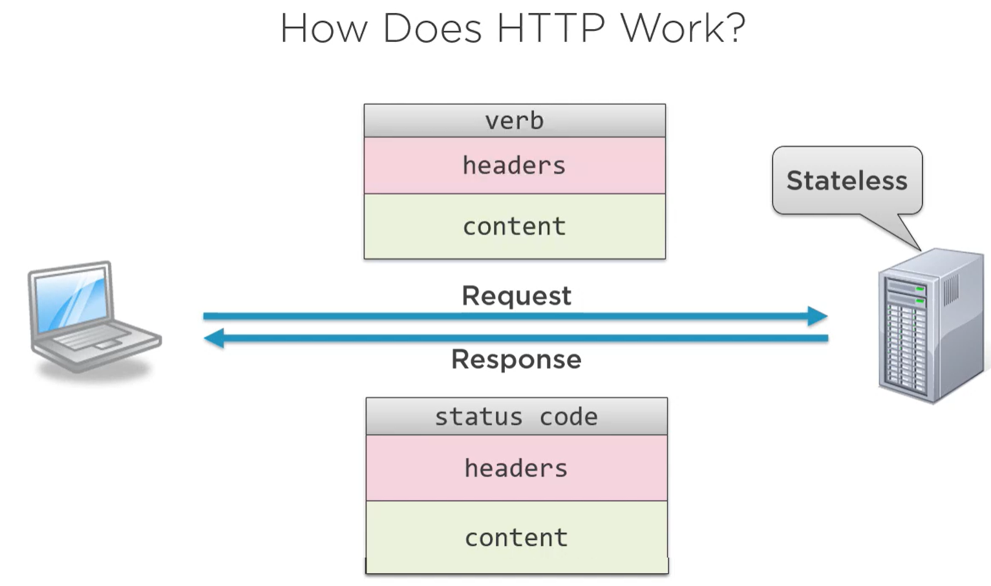
HTTP in a Nutshell
Overview

Slide 5
Request
verb
Action to perform on the server
GET: request resource
POST: create resource
PUT: update resource
PATCH: partial update resource
DELETE: delete resource
headers
Metadata of the request
Content Type: the format of content
Content Length: size of content
Authorization: who’s making the call
Accept: what type(s) can accept
Cookies: passage data in the request
content
Content concerning request
Html, css, xml,json
Content is not valid with some verbs
Information to help fulfill request
Binary and blobs common ( e.g. jpg)
Overview

Slide 6
Response
status code
Operation status
100-199: informational
200-299: success
300-399: redirection
400-499: client errors
500-599: server errors
headers
Metadata of the request
Content Type: the format of content
Content Length: size of content
Authorization: who’s making the call
Accept: what type(s) can accept
Cookies: passage data in the request
content
Content concerning request
Html, css, xml,json
Binary and blobs common ( e.g. jpg)
APIs often have their own types
Overview

Slide 7
1
rest
Notes:
Chapter Intro Slide (version I)
This slide should be used at the beginning of each “chapter” of your presentation (as introduced in the Agenda slide) to keep the audience aware of their place in the story and to help break things up. Change the text and chapter number accordingly. If you do not need a sub-head (the smaller text), delete it. Use different backgrounds for different chapter titles, try not to repeat a background.
Very short presentations (< ~10 slides) may not need Chapter Intro Slides.
There are multiple versions of this template with various white and black background images starting on slide 10.

Slide 8
What is REST?
REpresentational State Transfer
Concepts include:
Separation of client and server
Server requests are stateless
Cacheable requests
Uniform interface
REST

Slide 9
1
Designing a Restful API

Slide 10
What is an API?
Application Program Interface
represents the way multiple applications can interact with and obtain data from one another.
APIs operate on an agreement of inputs and outputs.
Designing a Restful API

Slide 11
REST APIs have several parts
Request
VERB
URI (query string)
Headers
Request body
Response
Status code
Headers
Response body
Designing a Restful API

Slide 12
URIs
URIs are just paths to Resource
e.g. api.yourserver.com/students
Query Strings for non-data elements
- use for non-resource properties
- e.g. format, sorting, searching (/students?sort=name)
Use unique identifiers
Does not have to be “primary keys”
Designing a Restful API

Slide 13
Nouns are Good, verbs are Bad
BAD
/getCustomers
/getCustomersByName
/getCustomersByPhone
/saveCustomer
/updateCustomers
/deleteCustomers
…
GOOD
/customers
/students
/products
…
Designing a Restful API
Allow filtering, sorting, and pagination
Handle errors gracefully and return standard error codes
Accept and respond with JSON

Slide 14
RestTemplate is a synchronous client to perform HTTP requests.
Adds the capability of transforming the request and response in JSON or XML to Java objects.
Some useful methods of RestTemplate:
getForEntity() - executes a GET request and returns an object of ResponseEntity class that contains both the status code and the resource as an object.
getForObject() - similar to getForEntity(), but returns the resource directly.
exchange() - executes a specified HTTP method, such as GET, POST, PUT, etc, and returns a ResponseEntity containing both the HTTP status code and the resource as an object.
execute() - similar to the exchange() method, but takes additional parameters: RequestCallback and ResultSetExtractor.
Rest template

Slide 15
delete() - deletes the resources at the given URL using the HTTP DELETE method.
put() - updates a resource for a given URL using the HTTP PUT method.
postForObject() - Creates a new resource using HTTP POST method and returns an entity.
Rest template

Slide 16
1
Hands-on

